Slide 1
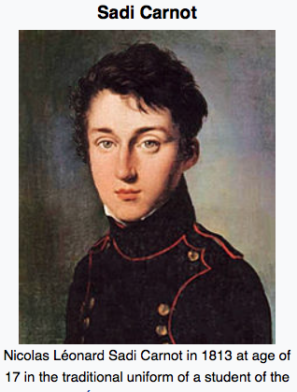
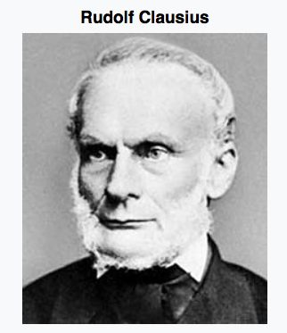
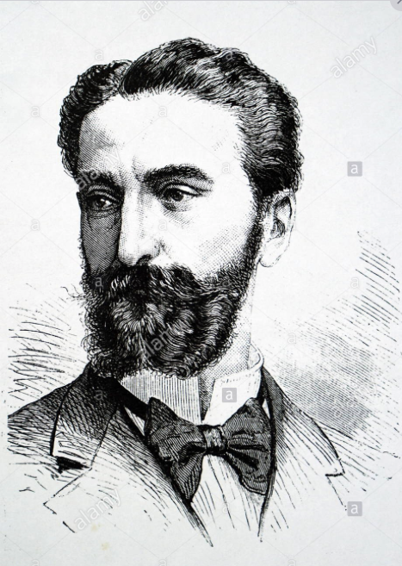

Slide 2
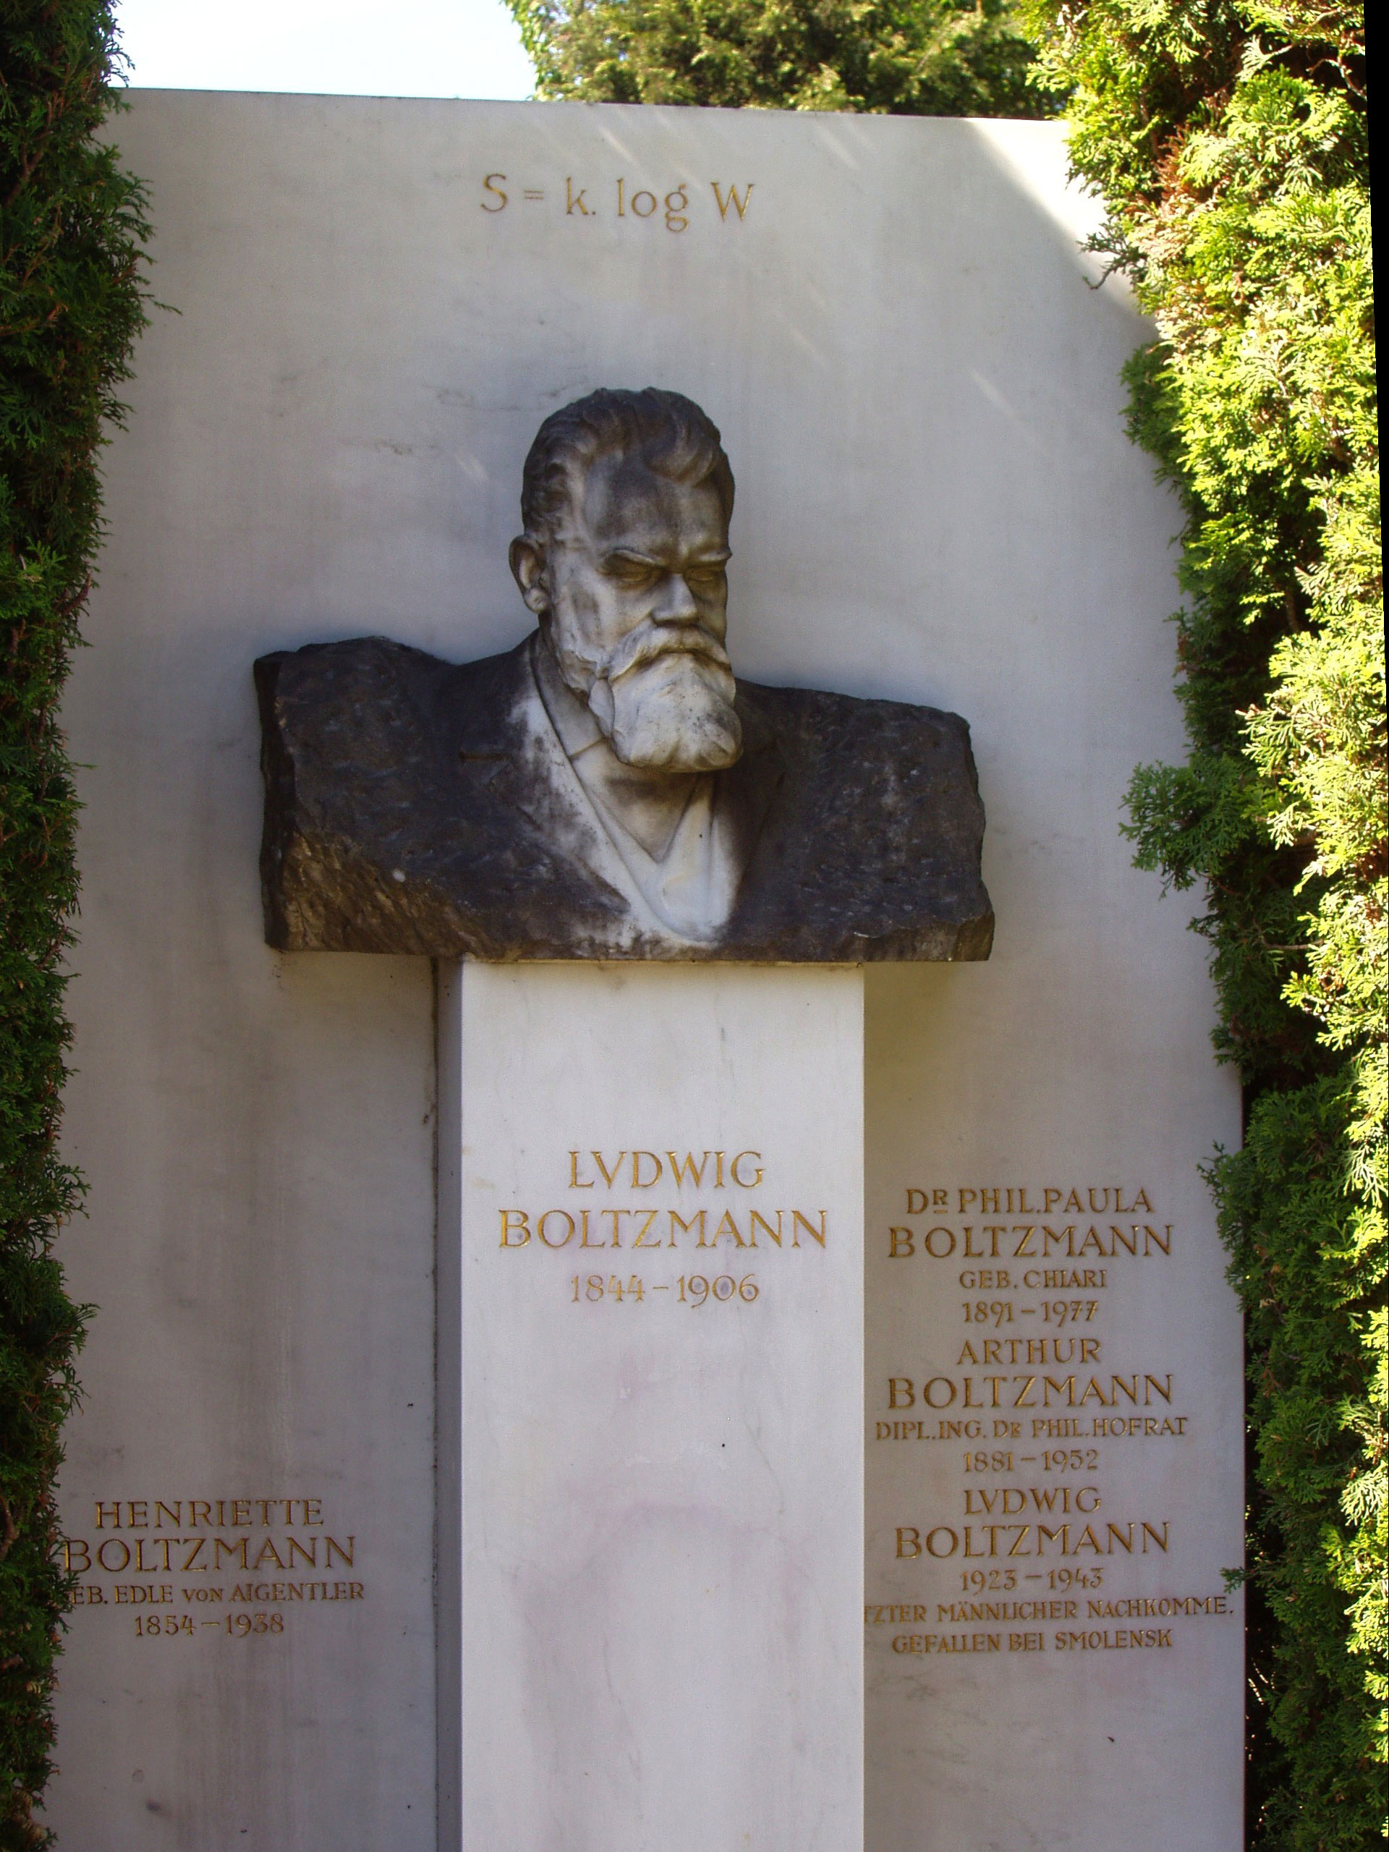
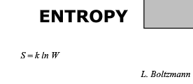
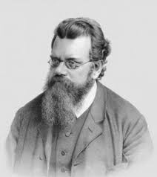

Slide 3
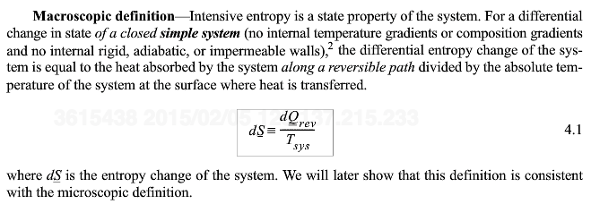
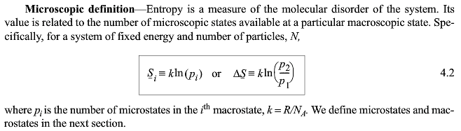

Engines (Calusius)
Statistics (Boltzmann)
For a single state ln(1) = 0. At absolute 0, in a perfect crystal with no defects etc.
Entropy of different aspects of a system, conformational entropy, translational entropy
A contribution to energy that is linear in temperature

Slide 4
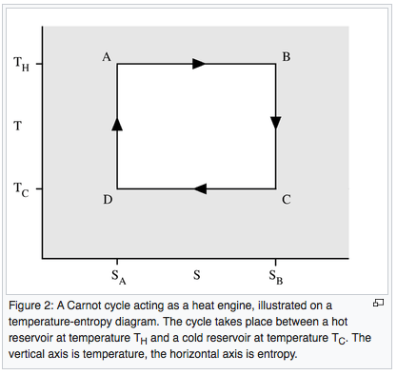

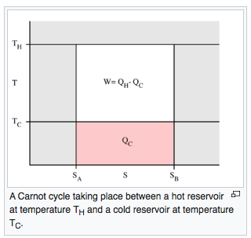

Slide 5

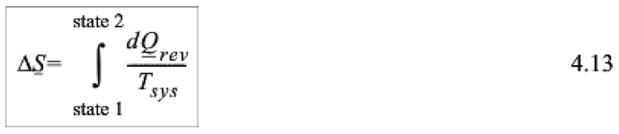
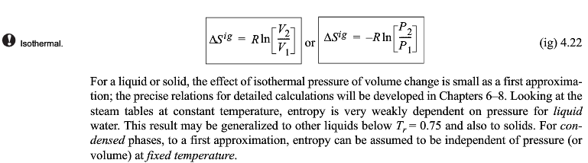
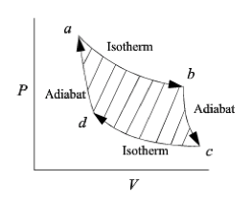

Slide 6
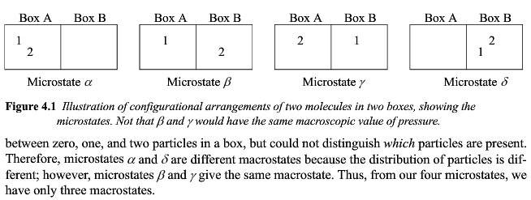
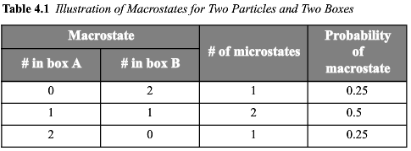
Statistical Thermodynamics (Mechanics)

Slide 7
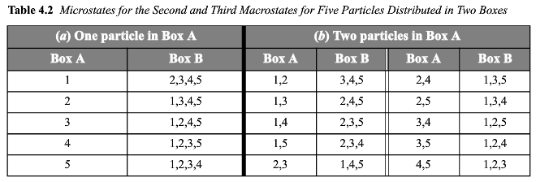
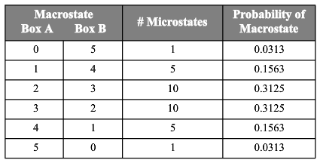

Slide 8
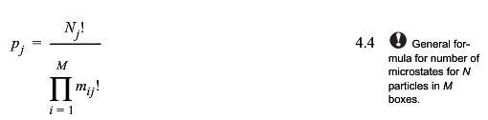


Slide 9
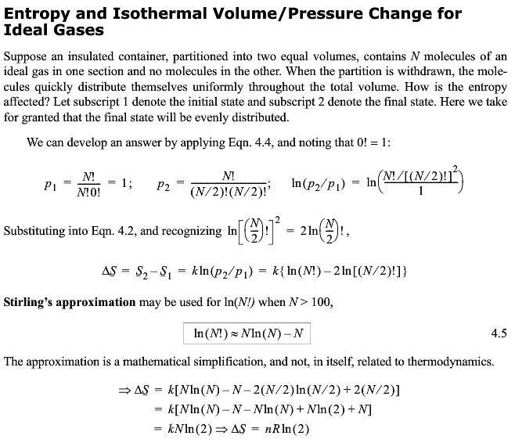

Slide 10
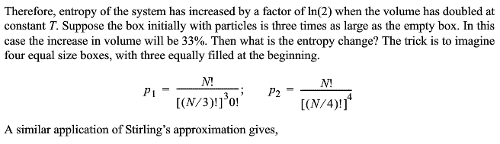
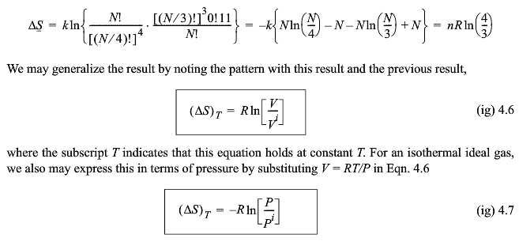

Slide 11
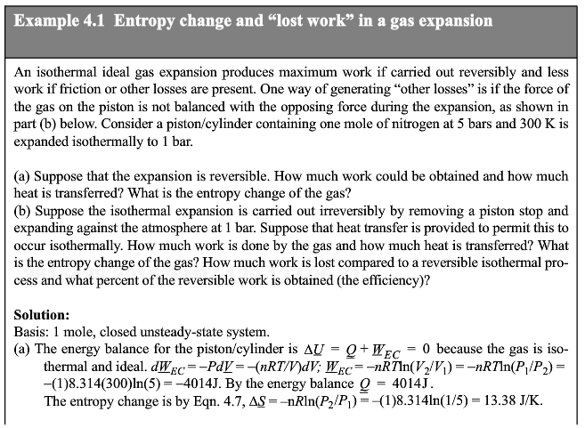
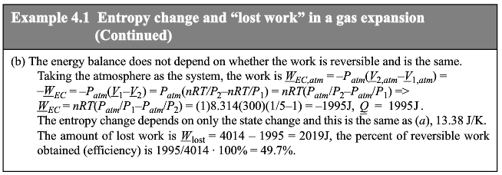

Slide 12
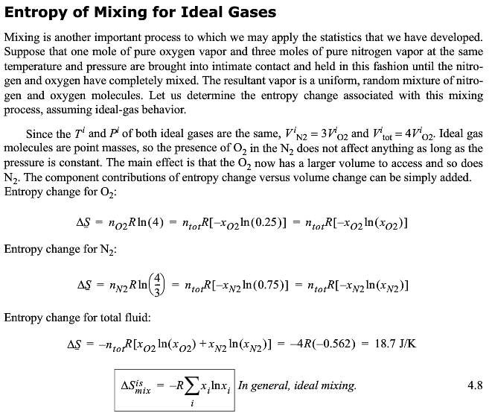
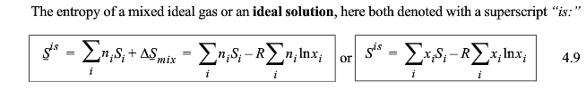

Slide 13
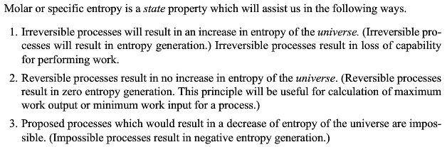
Defines “reversible” as ΔS = 0
Defines “impossible” as self-organizing;
ΔS < 0 with no energy input
Allows Calculation of Efficiency
S=0 process has no waste energy (heat)
Actually process has waste energy
Ratio of (W with waste)/S=0 work = efficiency

Slide 14
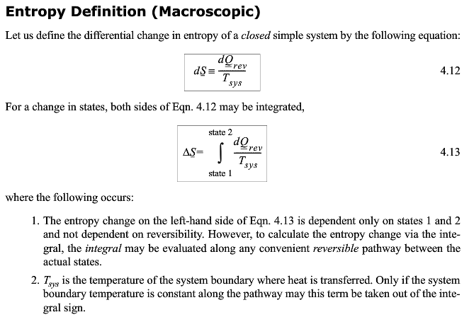

Slide 15
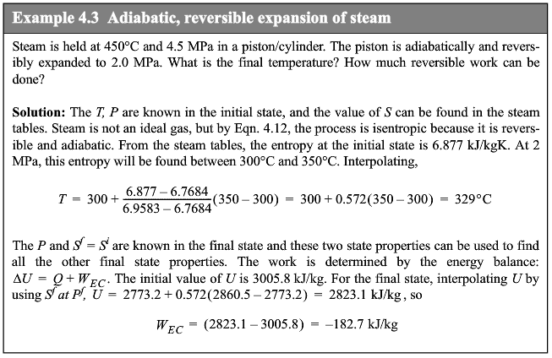

Slide 17
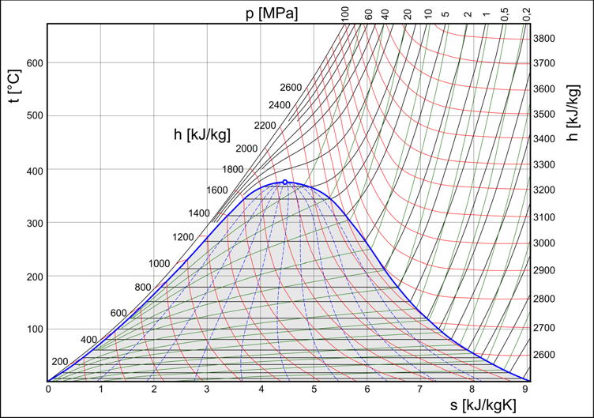
Water

Slide 18
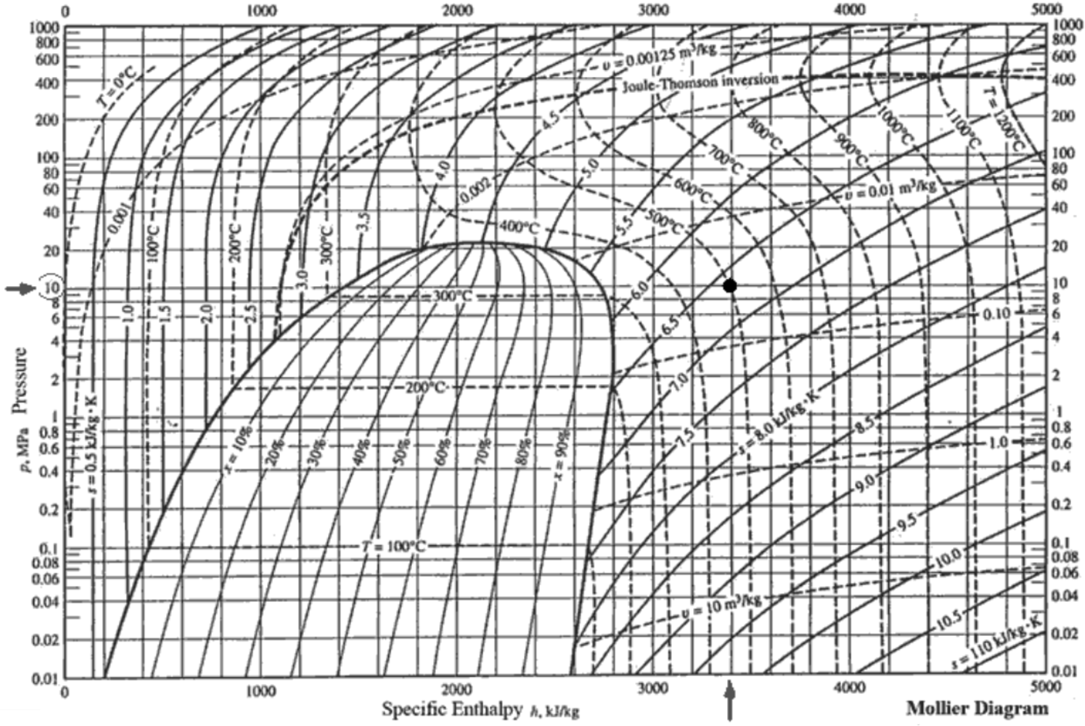
Water

Slide 19
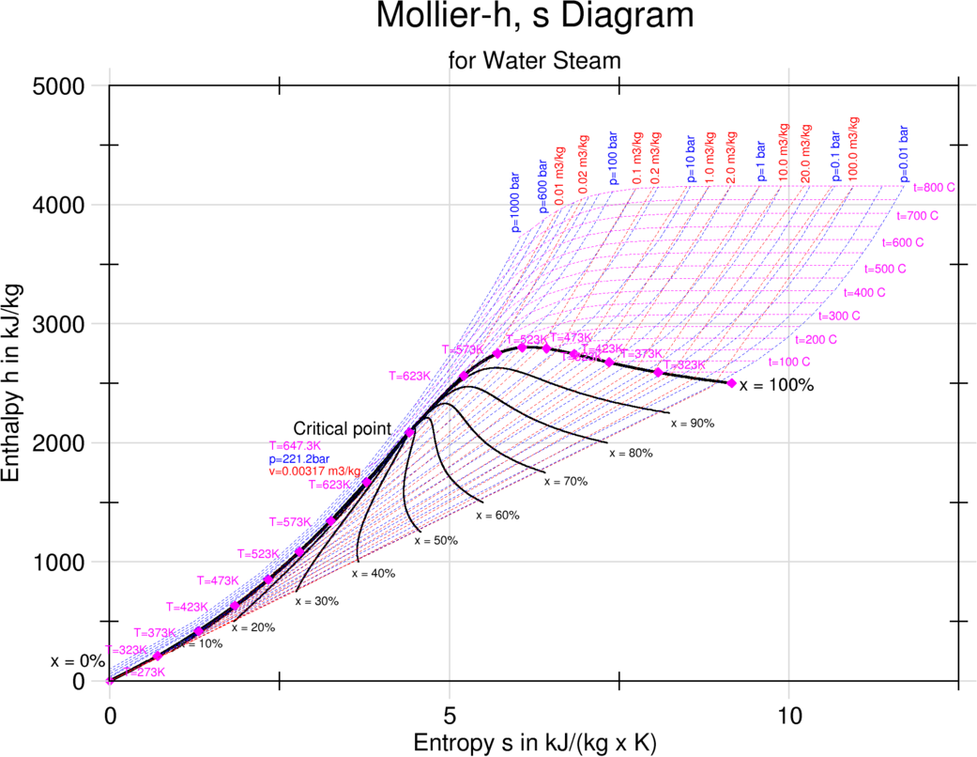
Water

Slide 20
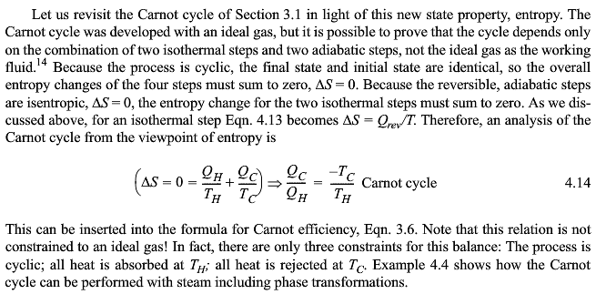
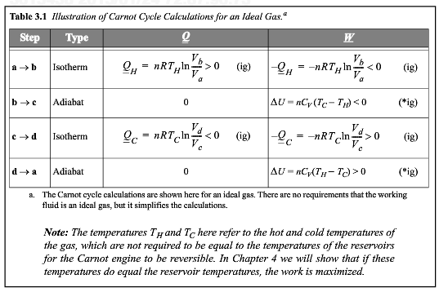

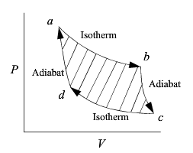

Slide 21
Rules for Carnot Cycle
Isothermal
(vary P) Q = -W_{EC} = -nRTln(V₂/ V₁)
Adiabatic
Reversible Q = 0 ΔS = 0
W_{EC} = ΔU = R C_{V} (T₂ – T₁)
Isobaric Q = ΔU - W_{EC} = ΔU + PΔV = ΔH
W_{EC} = -PΔV
For Turbine
The work done by the gas is work done by the turbine
(blades moved around by the gas) plus the work done
by pressures (flow work).
U₂ – U₁ = -W_{shaft} + P₁V₁ – P₂V₂ (adiabatic turbine)
-W_{shaft} = H₂ – H₁
Difference between shaft work and expansion/contraction work

Slide 22
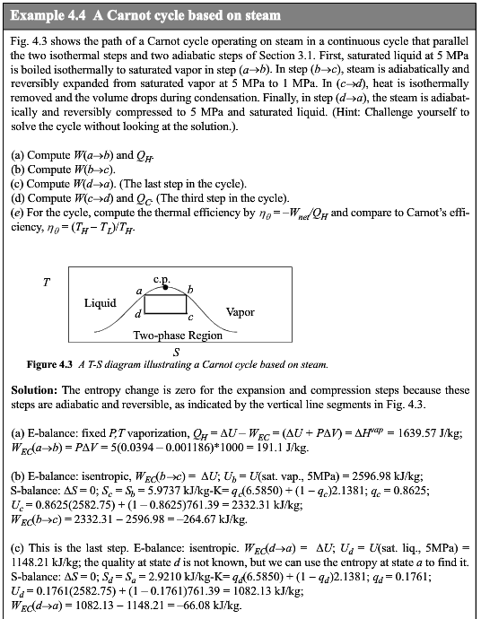

Slide 23
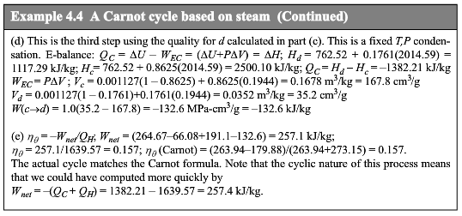

Slide 24
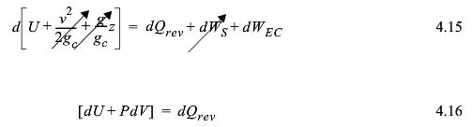
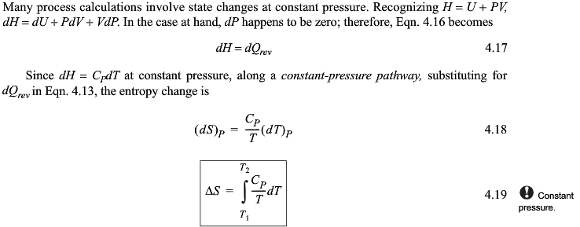

Slide 25
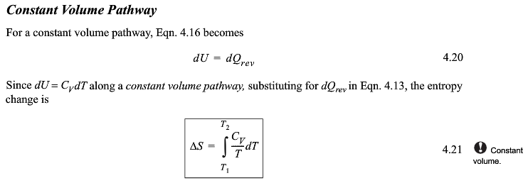

Slide 26
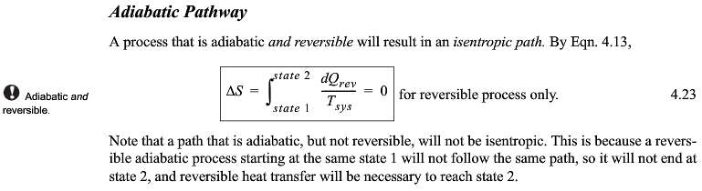
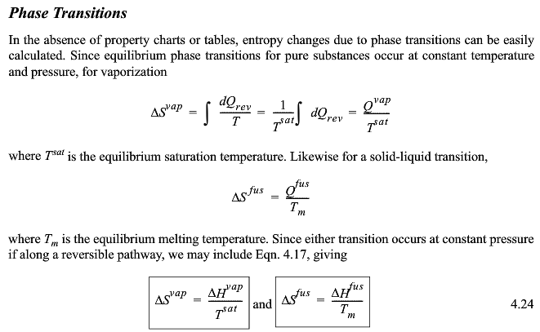

Slide 27
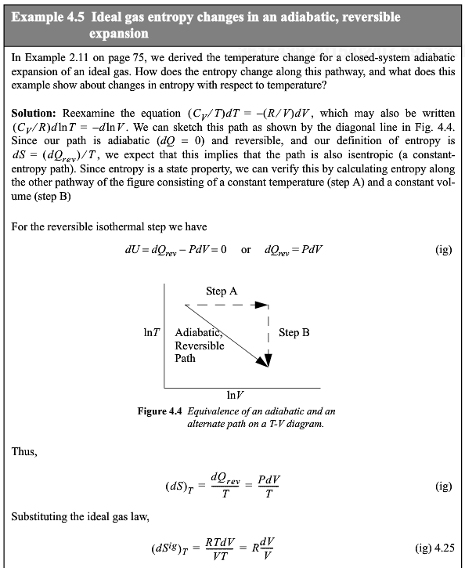
dU = -pdV

Slide 28
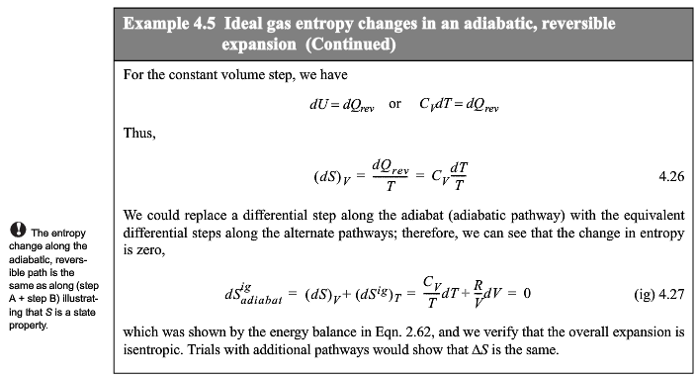
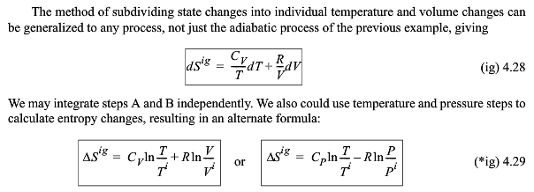

Slide 29
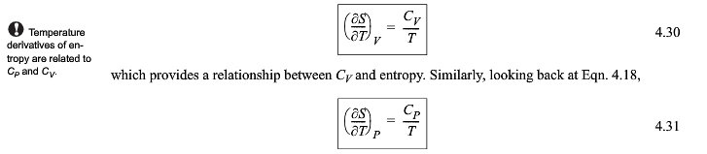
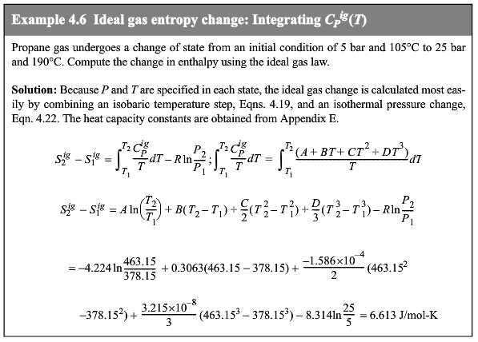
entropy

Slide 30
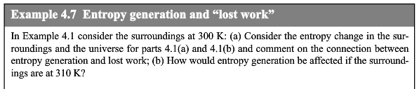
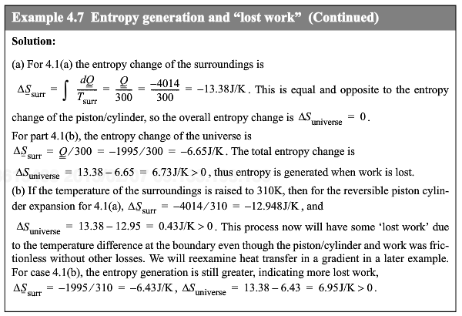
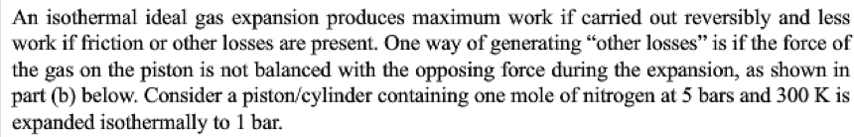
Reversible
Non-Reversible

Slide 32
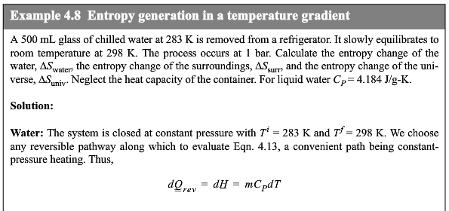


Slide 33




Slide 34


Slide 35


Slide 36



Slide 37


Slide 38





Slide 39



Slide 40


Slide 41




Need both energy and entropy balances

Slide 42

ΔH = 0
i.g. ΔT = 0 : ΔS = -Rln(P₂/P₁)
ΔS = 0 (no turbulence/reversible)

Slide 43


Adiabatic, reversible, i. g.

Slide 44


ΔS = 0 (no turbulence/reversible)

Slide 45
Summary of Process and General Rules
Nozzle ΔS = 0
ΔH=Δ(1/2 mv²)
Isothermal (ΔS)_{T} = R ln[V₂/V₁] i.g.
= -R ln[P₂/P₁]
(ΔH)_{T}=0
Ideal Mixing ΔS_{mix} = -R Σx_{i} lnx_{i}
Adiabatic, Reversible
ΔS = 0
Isobaric (dS)_{P} = C_{p} (dT)_{P}/T
(dS/dT)_{P} = C_{p}/T
Constant Volume
(dS)_{V} = C_{V} (dT)_{V}/T
(dS/dT)_{V} = C_{V}/T
Phase Change ΔS_{trans} = ΔH_{trans}/T_{trans}
Throttle ΔS = -Rln(P₂/P₁) (i.g.)
ΔH=1/2 mv²
Generally ΔH=0
Pump ΔS = 0 for adiabatic reversible
ΔH=W_{S}= ΔH’/η_{eff}
Turbine ΔS = 0 for adiabatic reversible
ΔH=W_{S}= ΔH’η_{eff}
Carnot (Use °K)
Engine η_{eff} = (T_{H} - T_{C})/T_{H}
Refrigerator COP = T_{C}/(T_{H} - T_{C})
Heat Pump COP = T_{H}/(T_{H} - T_{C})

Slide 46



Slide 47



Slide 48



Slide 49





Slide 50
Water

Slide 51
Water

Slide 52
Water

Slide 53





Slide 54



Slide 55



Slide 56


Slide 57




Slide 58

Reasons for multistage:
-Rotation speed of turbine for electricity generation is fixed single stage spins too fast
-Recovery of heat from different stages and use of different pressure steam in a process
-Overall efficiency increases with number of stages difference in ΔH’ and ΔH is smaller for smaller pressure drops.
-Equipment and maintenance costs go up with number of stages

Slide 59



Slide 60



Slide 61



Slide 62



Slide 63


Slide 64


Slide 65



Slide 66

Dead State = surroundings at T₀ and P₀
Exergy, B, is the Gibbs, G, free energy available for a system to reach the dead state

Slide 67




Slide 68


Slide 69




Slide 70



Slide 71



Slide 72




